Slide 1
Market Making Mechanisms and Liquidity Dynamics in Blockchain-Based Prediction Markets
Parshant Singh
Masters Thesis Final Presentation, 01.09.2025

Slide 2
Outline
Background and Motivation
Research Questions
Methodology
Results
Conclusion

Slide 3
Background and Motivation
  Prediction markets are platforms for betting on outcome of future events.
  Users can bet on an outcome by buying shares of outcome token.
  Price of the shares reflect crowd-sourced probability estimates
  Example: Polymarket

Slide 4
Background and Motivation
Liquidity Provider / Market Maker
Liquidity providers (market makers) enable trading in markets by committing assets via limit orders or collateral in liquidity pools.
E.g - Citadel in traditional finance, Users in decentralised finance, Currency exchanges at airports.

Slide 5
Background and Motivation
Automated Market Maker (AMM)
An Automated Market Maker (AMM) is a decentralized trading mechanism that facilitates the buying and selling without relying on a centralized exchange or order book.
E.g - Constant Product Market Makers (x * y = k)

Slide 6
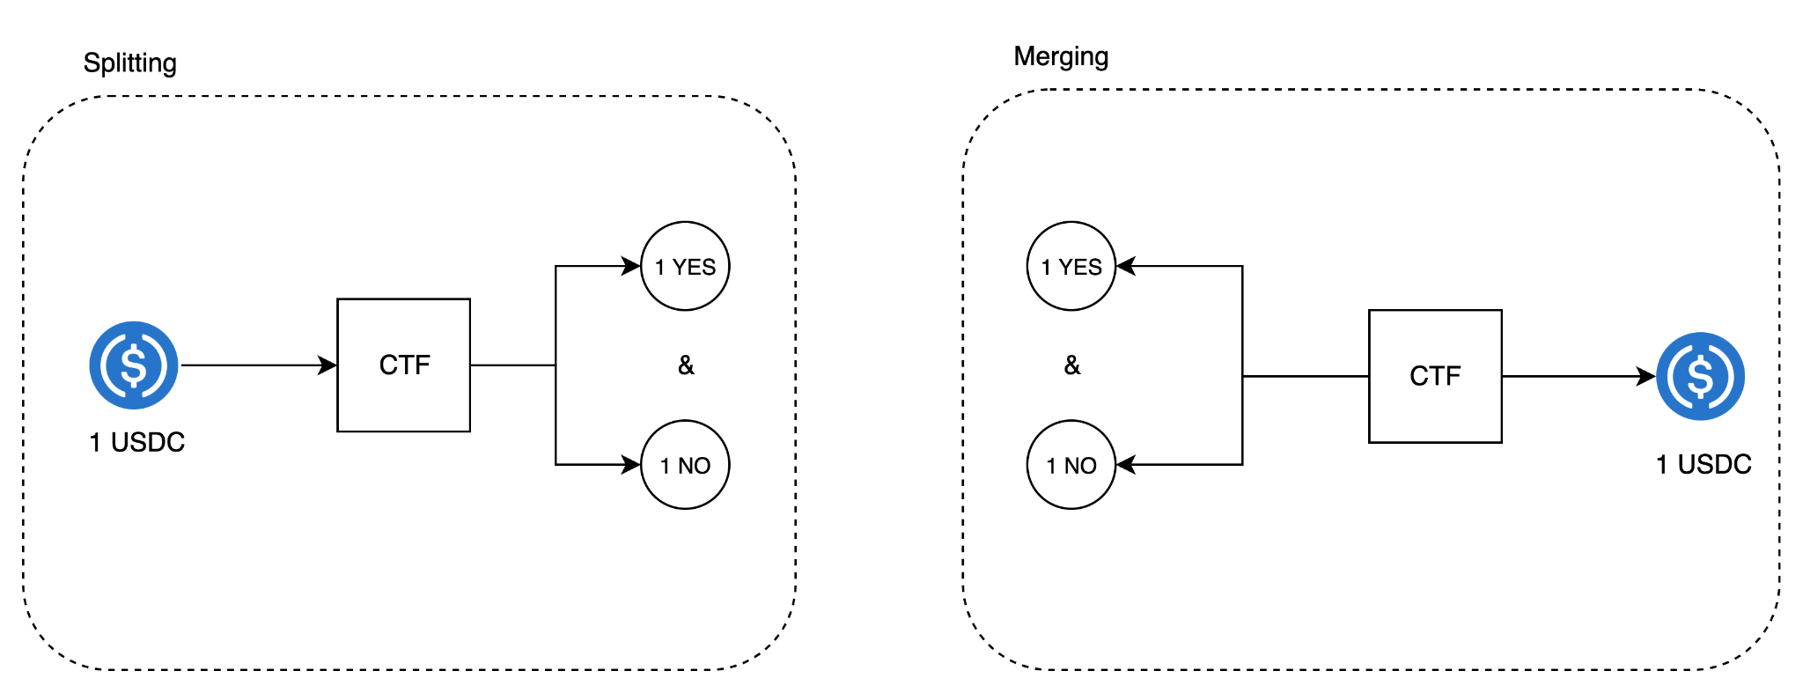
Background and Motivation
Gnosis Conditional Token Framework (CTF)
Allows splitting and merging of collateral

Slide 7
Background and Motivation
How pricing works in AMM-based prediction markets ?

Slide 8
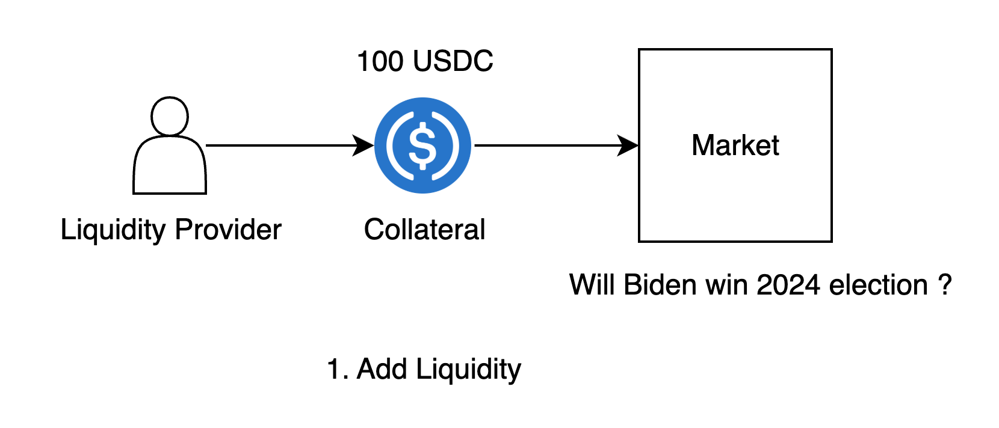
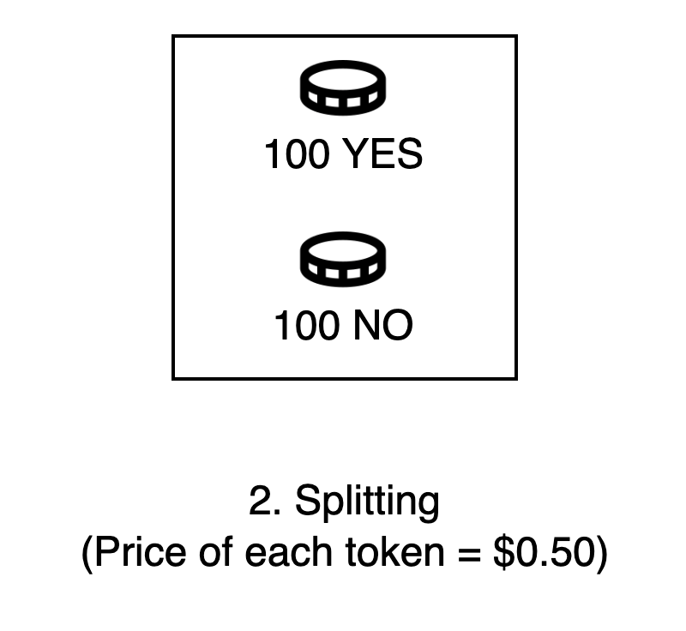
Background and Motivation
x * y = K
100 * 100 = 10,000

Slide 9
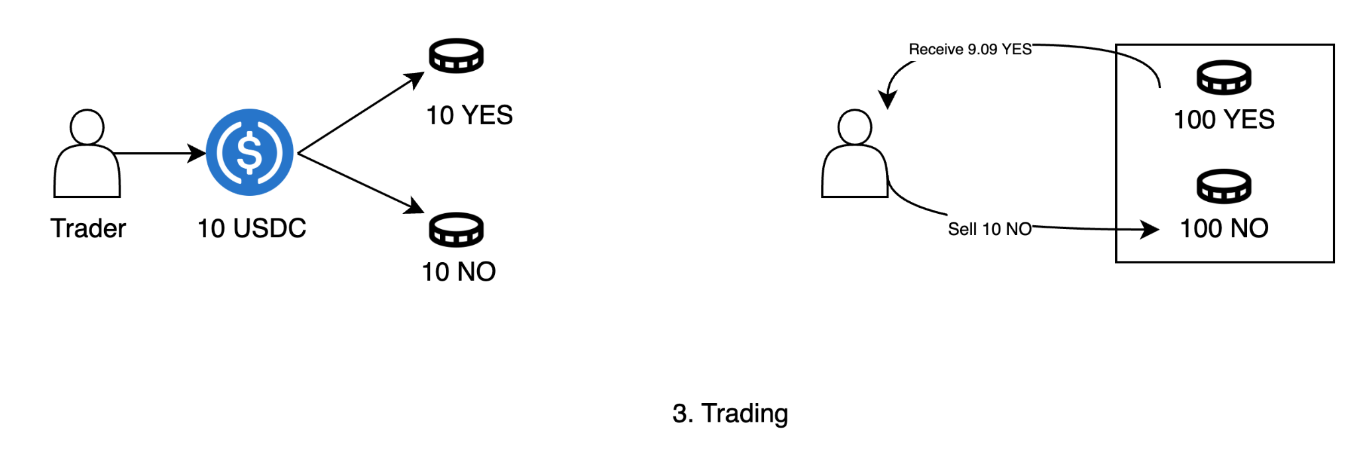
Background and Motivation
(100 - x)*(100 + 10) = 10000 => x = 9.09
Trader is left with 19 YES tokens
Pool has 110 NO tokens and 91 Yes tokens.

Slide 10
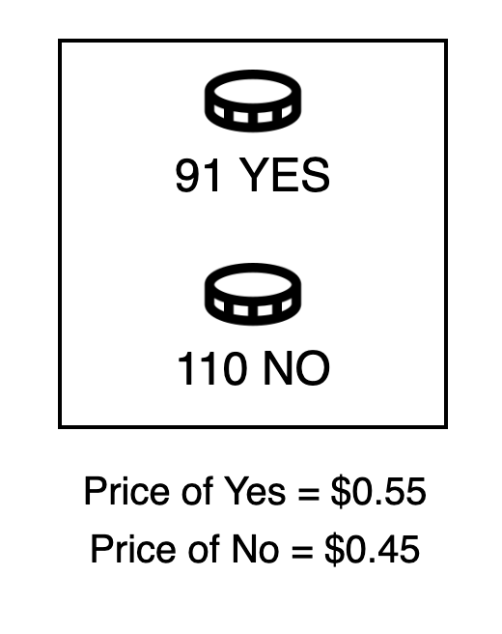
Background and Motivation
Price of YES token: 110/201 = $0.55, Price of No token: 91/201 = $0.45

Slide 11
Background and Motivation
Impermanent Loss

Slide 12
Background and Motivation
Impermanent loss is a temporary reduction in value experienced by liquidity providers (LPs) in AMM pools due to price fluctuations.
Removing liquidity amid volatility makes losses permanent.

Slide 13
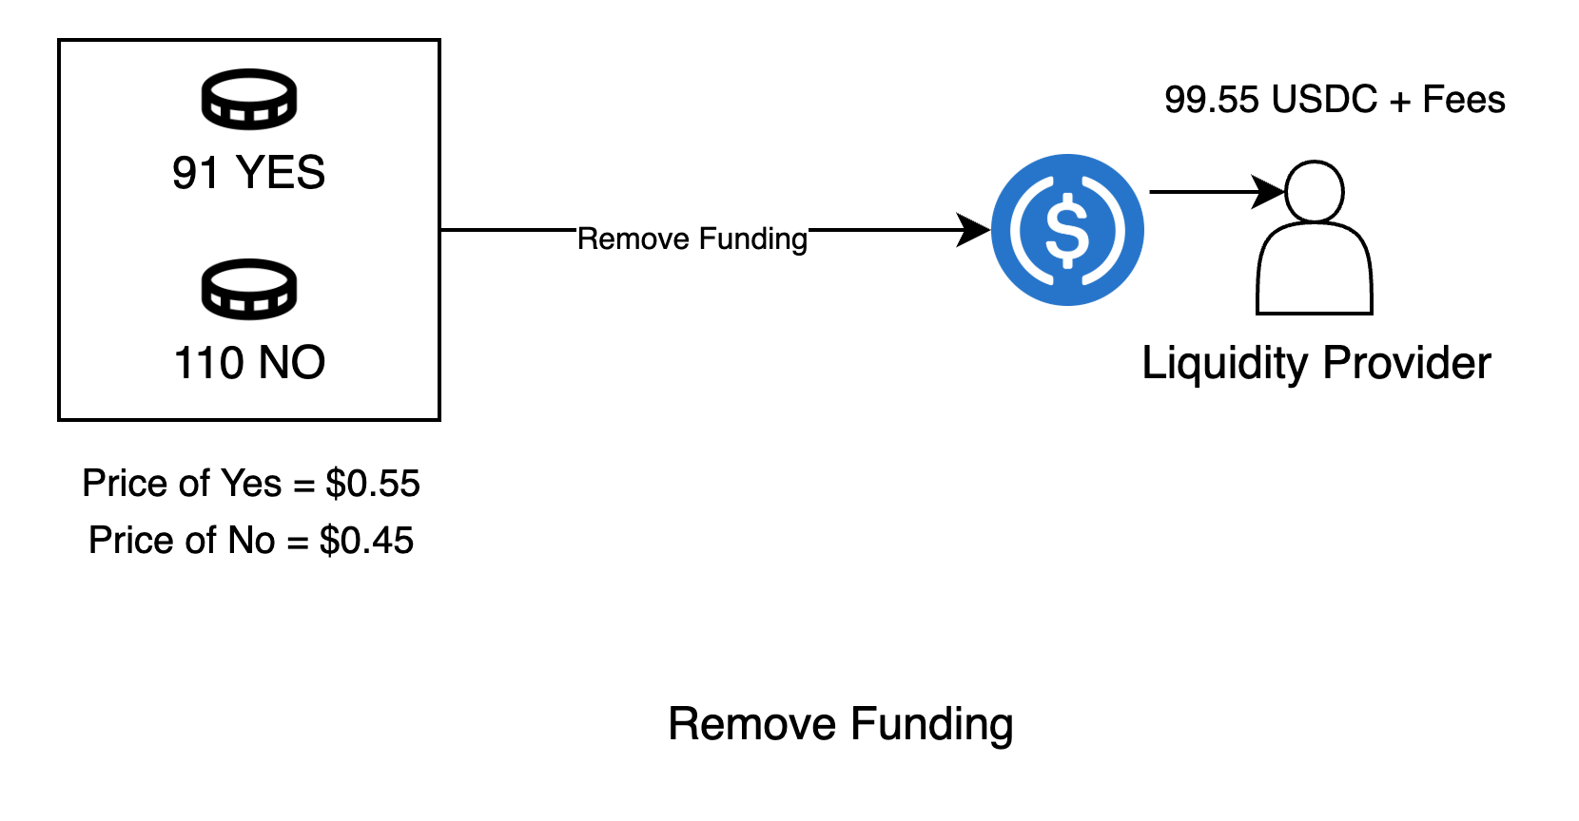
Background and Motivation
Realised Loss = 100 - (99.55 + Fees)

Slide 14
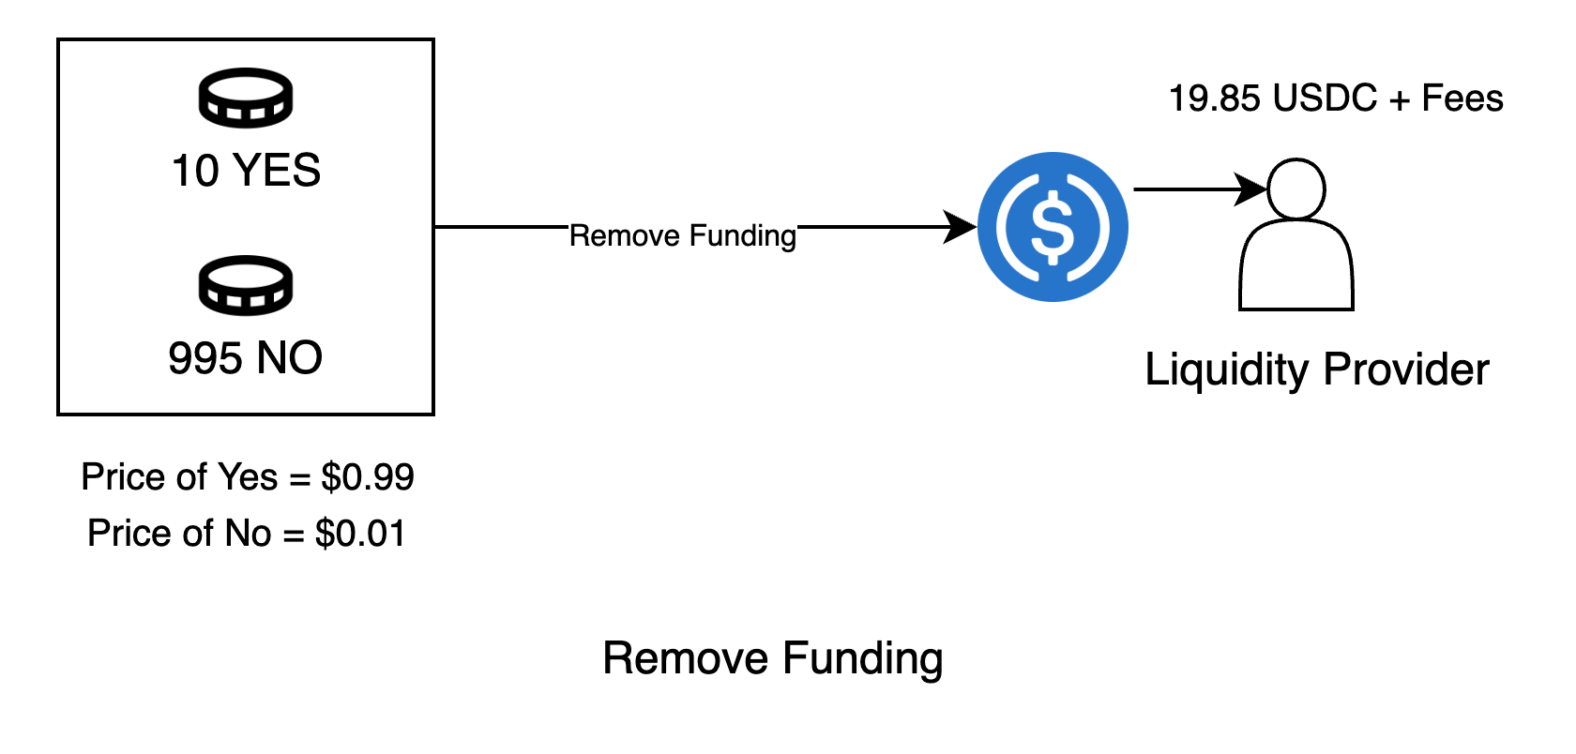
Background and Motivation
Realised Loss = 100 - (19.85 + Fees)
Closer to resolution, LP is left with worthless tokens

Slide 15
Background and Motivation
How pricing works in Central Limit Order Book (CLOB) design.

Slide 16
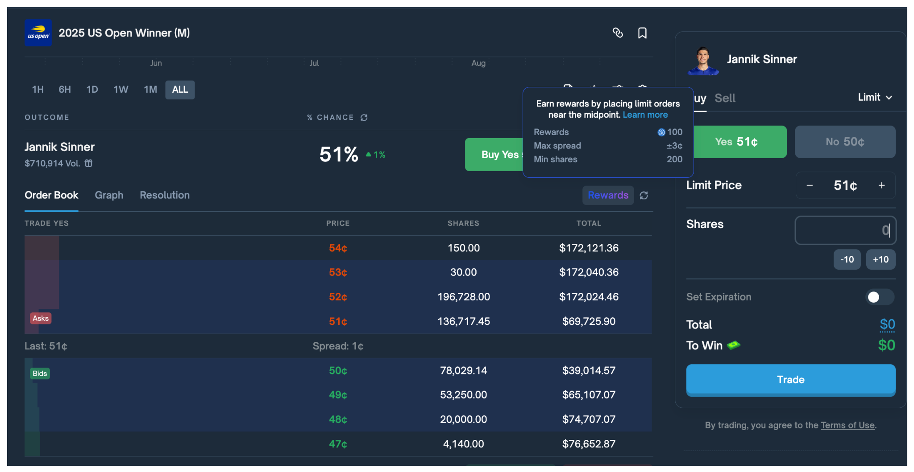
Background and Motivation

Slide 17
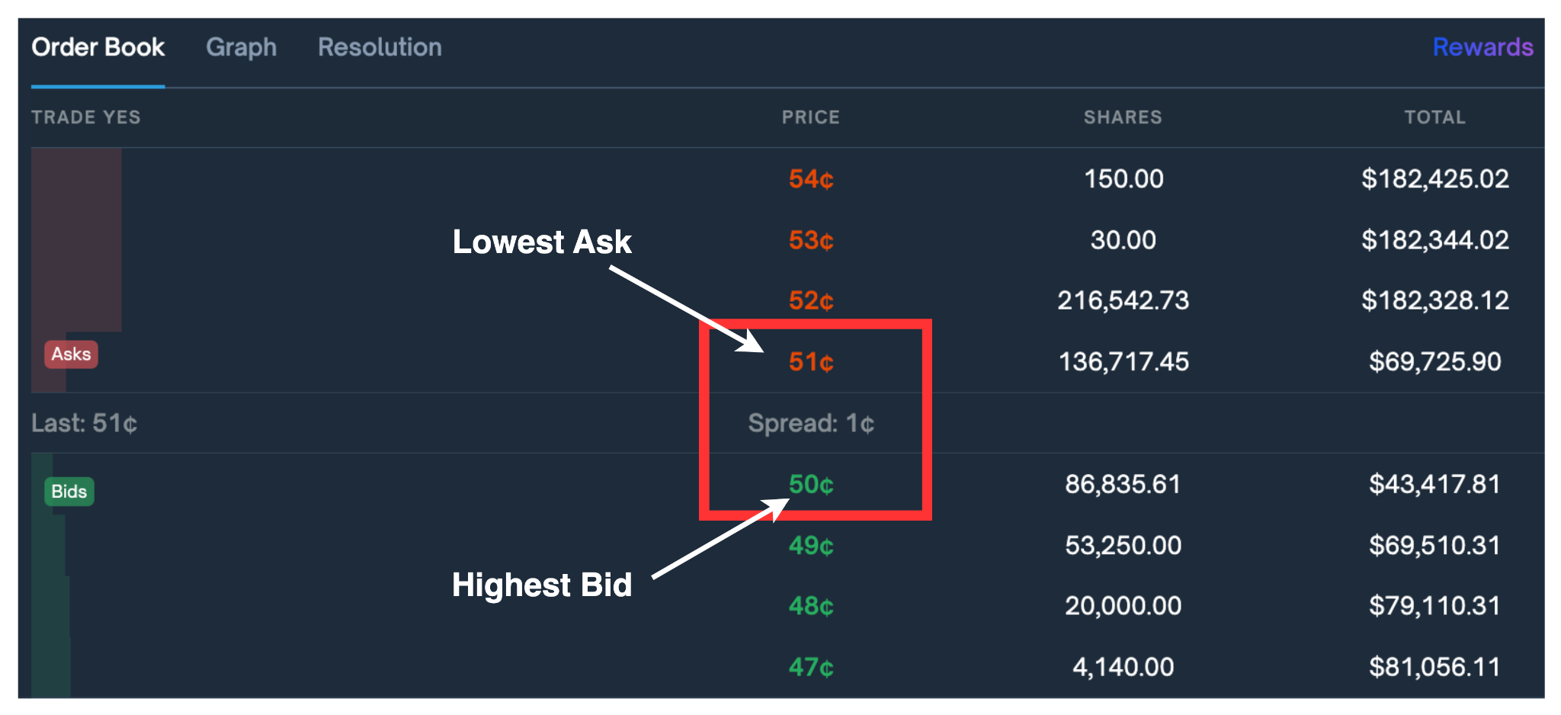
Background and Motivation

Slide 18
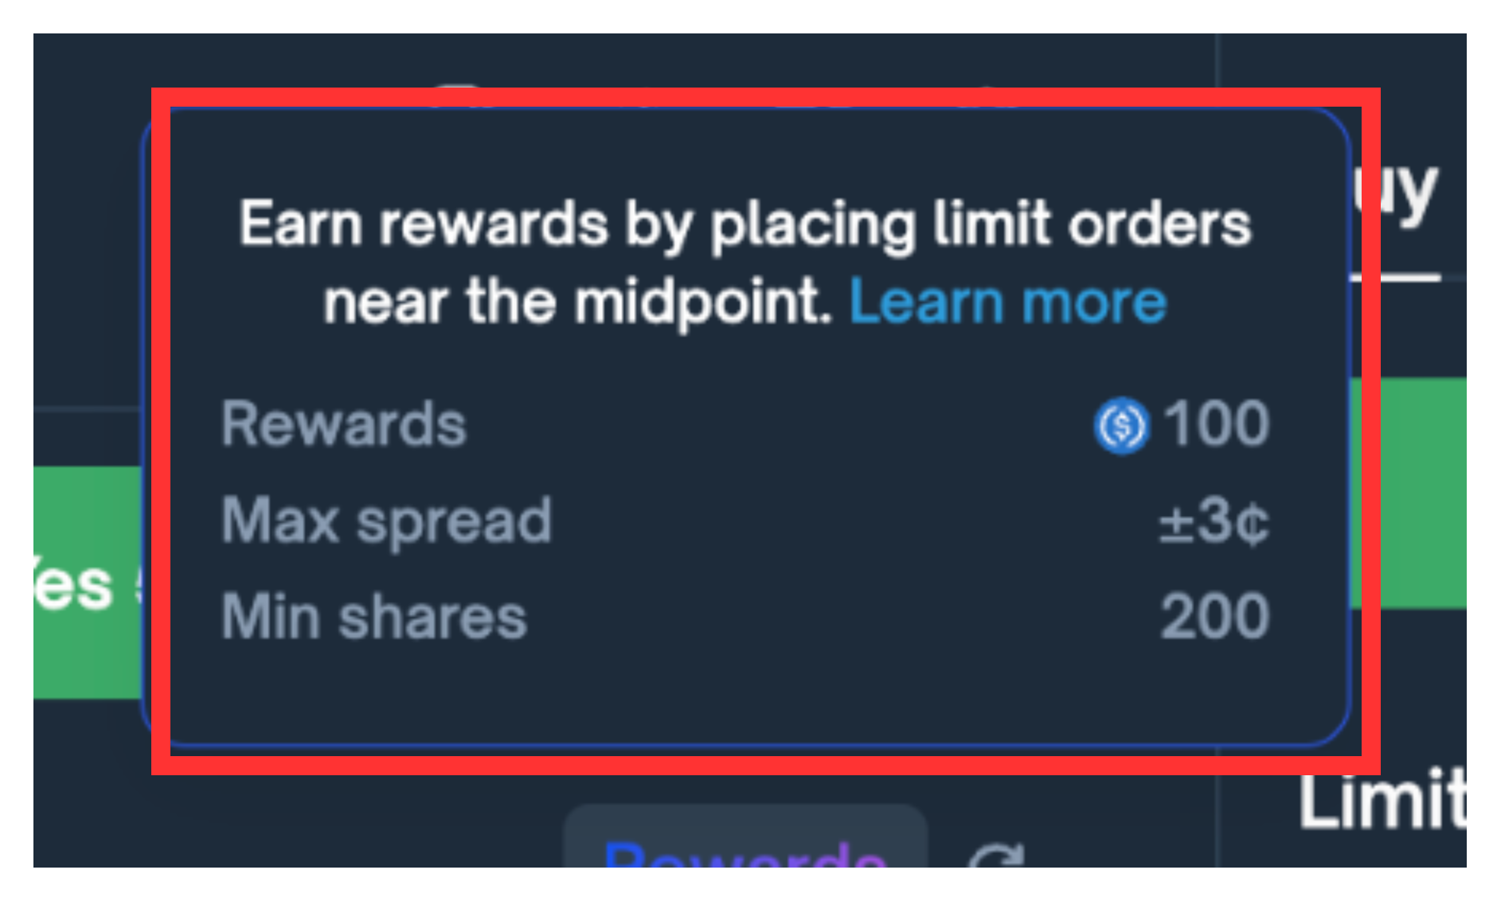
Background and Motivation

Slide 19
Background and Motivation
Types of Decentralised Prediction Markets
AMM Based
CLOB Based (Central Limit Order Book)
Usually based on constant function algorithm
Polymarket (pre-2023)
Orders matched off chain and settled on-chain
Polymarket (post 2023)
Low fees for traders (easy access to liquidity)
Higher spread (more fee for LPs)
– LPs Suffer from Impermanent loss
– Requires active market making

Slide 20
Outline
Background and Motivation
Research Questions
Methodology
Results
Conclusion

Slide 21
Research Questions
RQ1: What factors determine the profitability of liquidity provision in AMMs on Polymarket prediction markets ?
RQ2: How can liquidity providers optimize their strategies to improve profitability in prediction market AMMs ?
RQ3: What determines the profitability of market making strategies in Central Limit Order Books for prediction markets?

Slide 22
Outline
Background and Motivation
Research Questions
Methodology
Results
Conclusion

Slide 23
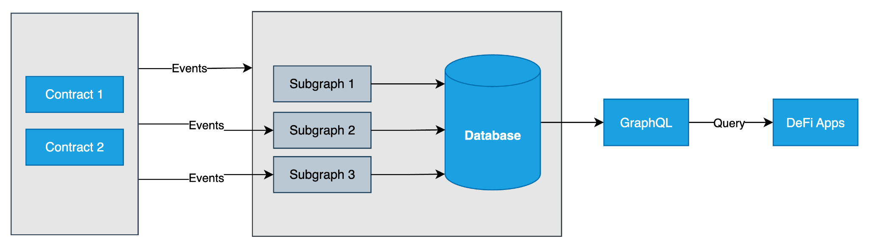
Methodology
Data gathering:
Subgraph - Indexing and querying on-chain data through graphql API
Polymarket Gama API - CLOB data
Polygon RPC nodes for historical data - Transaction details
Source: https://community.nasscom.in/communities/blockchain/how-defi-applications-can-benefit-using-subgraphs-data-indexing

Slide 24
Methodology
Datasets
AMM
CLOB
2643 unique markets.
~3000 unique LPs
~150,000 funding events
3100 unique markets
800 unique LPs (>=2 Buy/Sell and min 5 markets)
~1.2M matched orders

Slide 25
Methodology
Data Analysis
Calculating Impermanent losses across markets
  Keep track of the inventory of each LP and calculate losses at each liquidity removal and resolution
  P&L of each LP and LP-market pair
Patterns in providing and removing liquidity
  Volume-liquidity analysis
  Holding of LP shares relative to resolution
P&L of the LPs on CLOB markets
  Calculate the P&L of each LP and LP-market pairs from matched orders inputs
  Find profitable LPs and LP-market pairs
Rewards distribution
  Track all rewards distributed by Polymarket rewards contract

Slide 26
Outline
Background and Motivation
Research Questions
Methodology
Results
Conclusion

Slide 27
Results (AMM)
AMM-based Polymarket Design

Slide 28
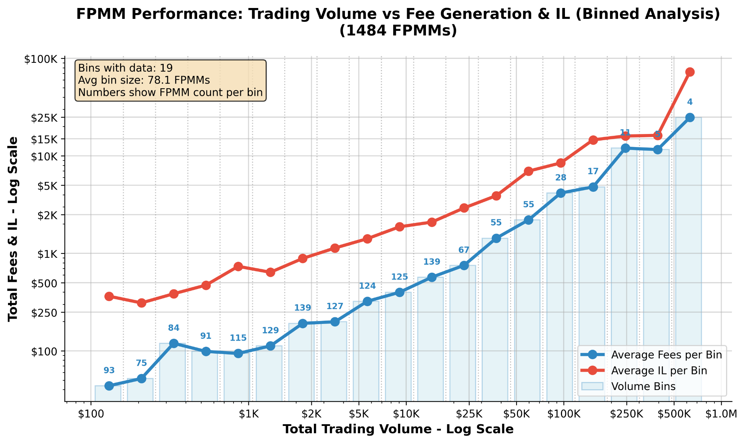
Results (AMM)
Fee-Generation & IL vs Trading Volume
Inference
Avg Impermanent Loss > Avg Fees overall.
Higher Volume markets earns higher Fees
Not sustainable and need to be subsidised

Slide 29
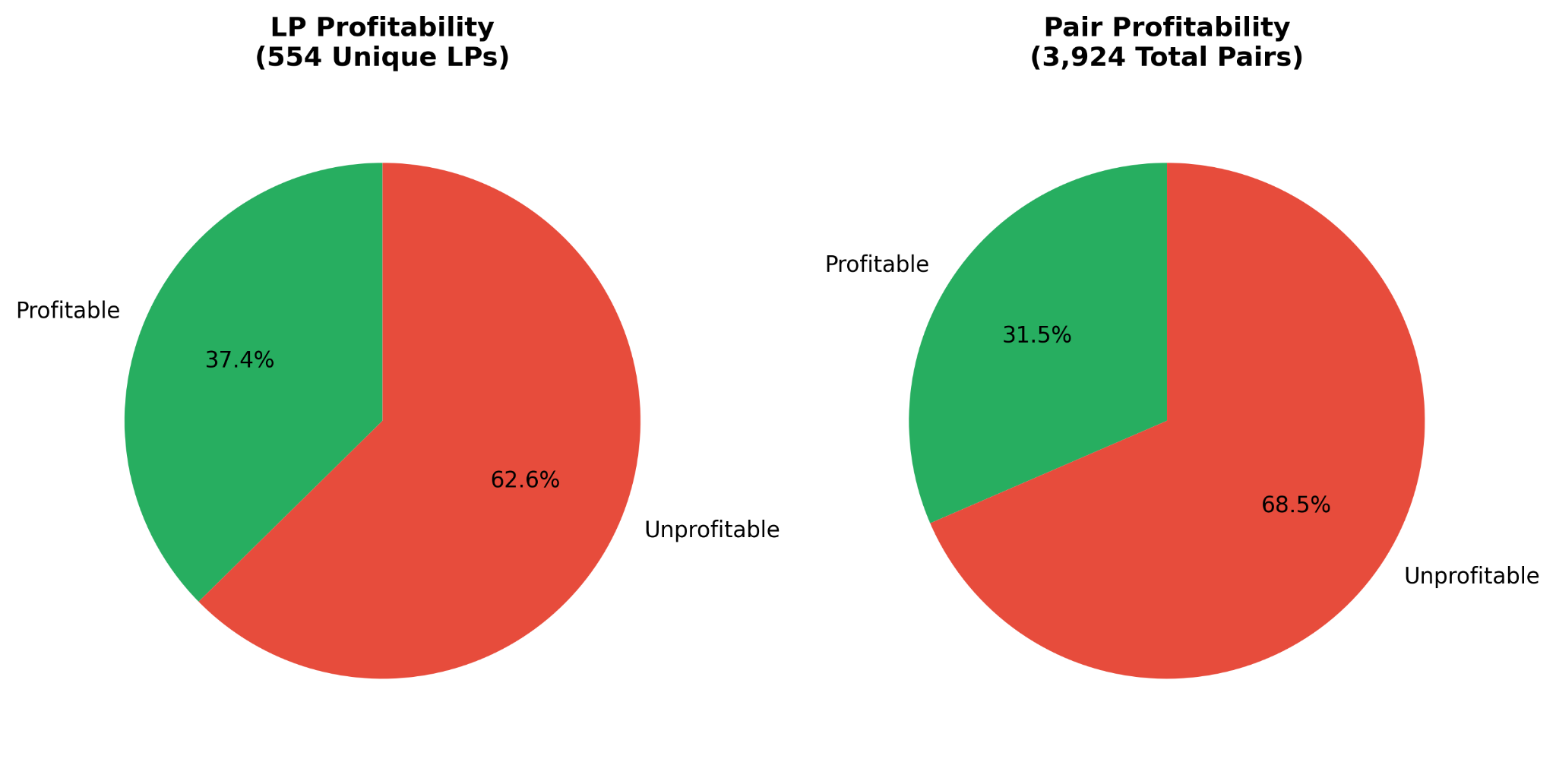
Results (AMM)
Profitability pie chart for LPs and LP-Market pairs
Inference
LPs suffer from losses overall

Slide 30
Results (AMM)
Strategies deployed by LPs in AMM-design
2 notable strategies observed:
Removing liquidity near resolution
Just-In-Time Liquidity attack

Slide 31
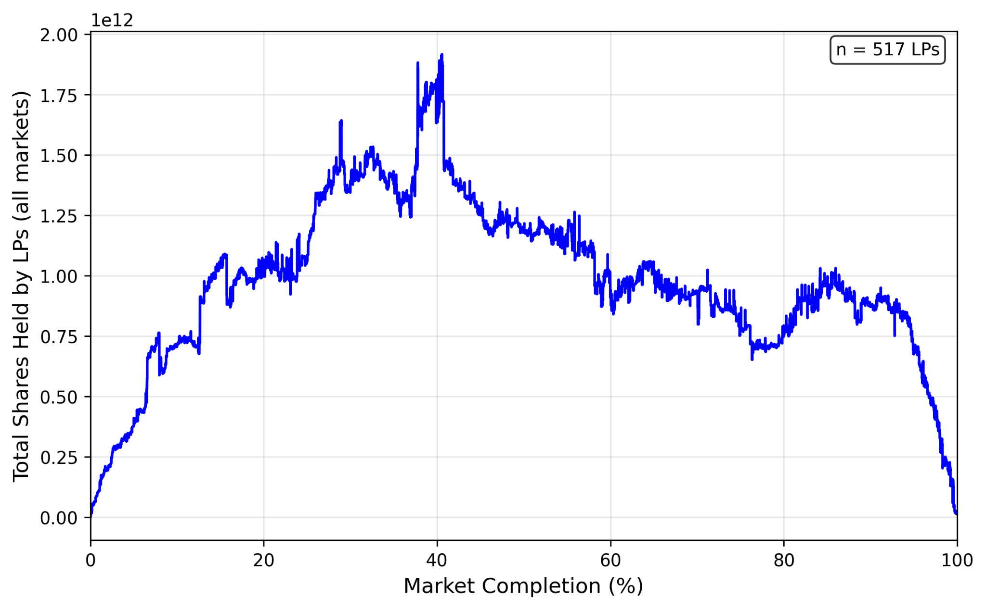
Results (AMM)
Shares/LP tokens held by the profitable LPs over all markets
Inference
Profitable LPs remove liquidity near the market resolution.
Helps avoid loss from one token becoming worthless.

Slide 32
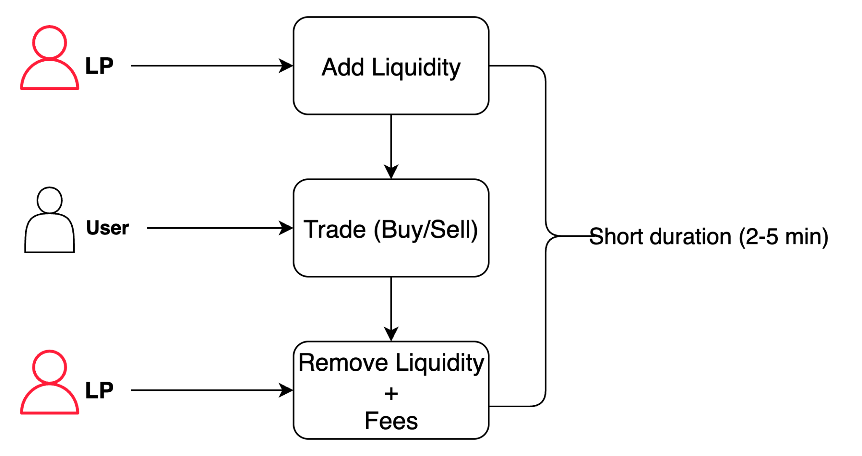
Results (AMM)
Just-In-Time Liquidity
Found ~20,000 such transactions
Total fees captured ~$15,000
Beneficial for User (less slippage)
Passive LPs lose on fees

Slide 33
Results
Central Limit Order Book (CLOB)

Slide 34
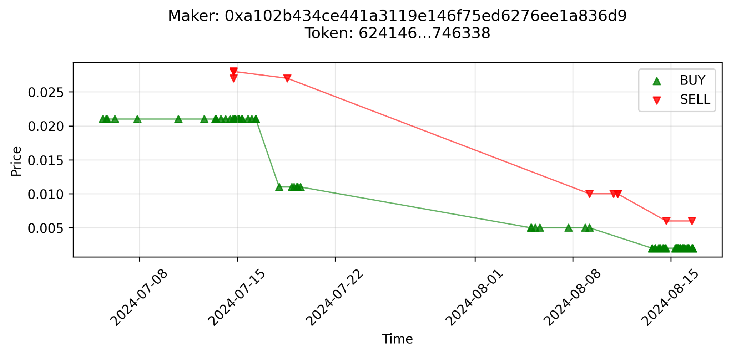
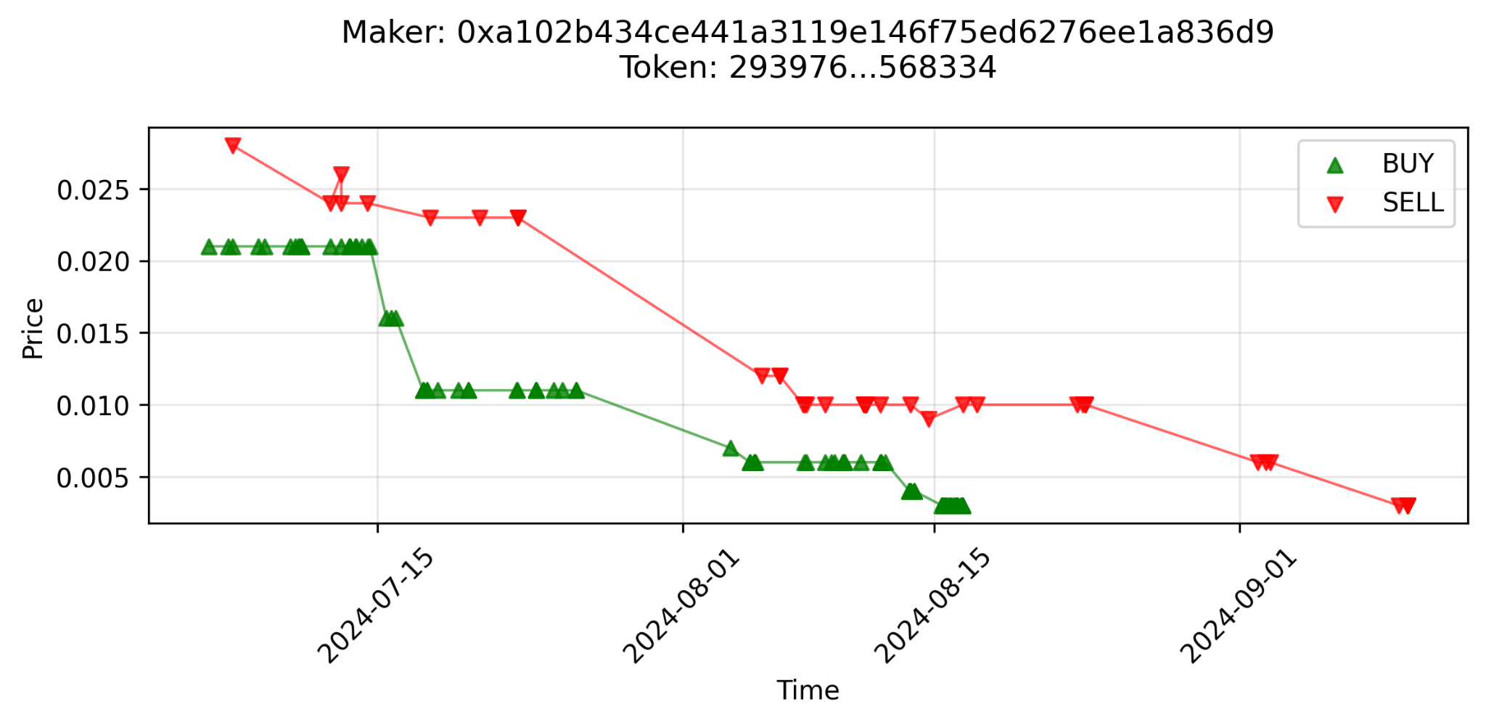
Results (CLOB)
Adjusting Bids and Asks by LPs
LPs adjust their bids and asks as the price changes
LPs profit will be the spread

Slide 35
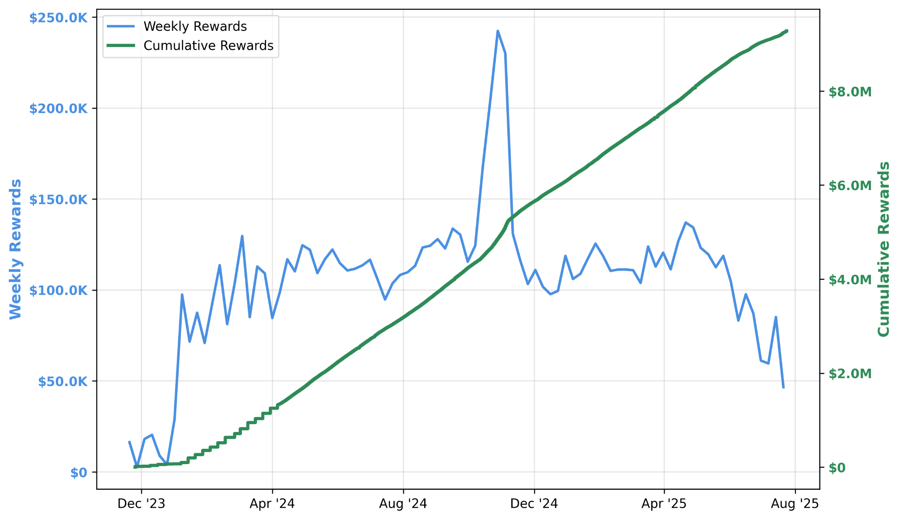
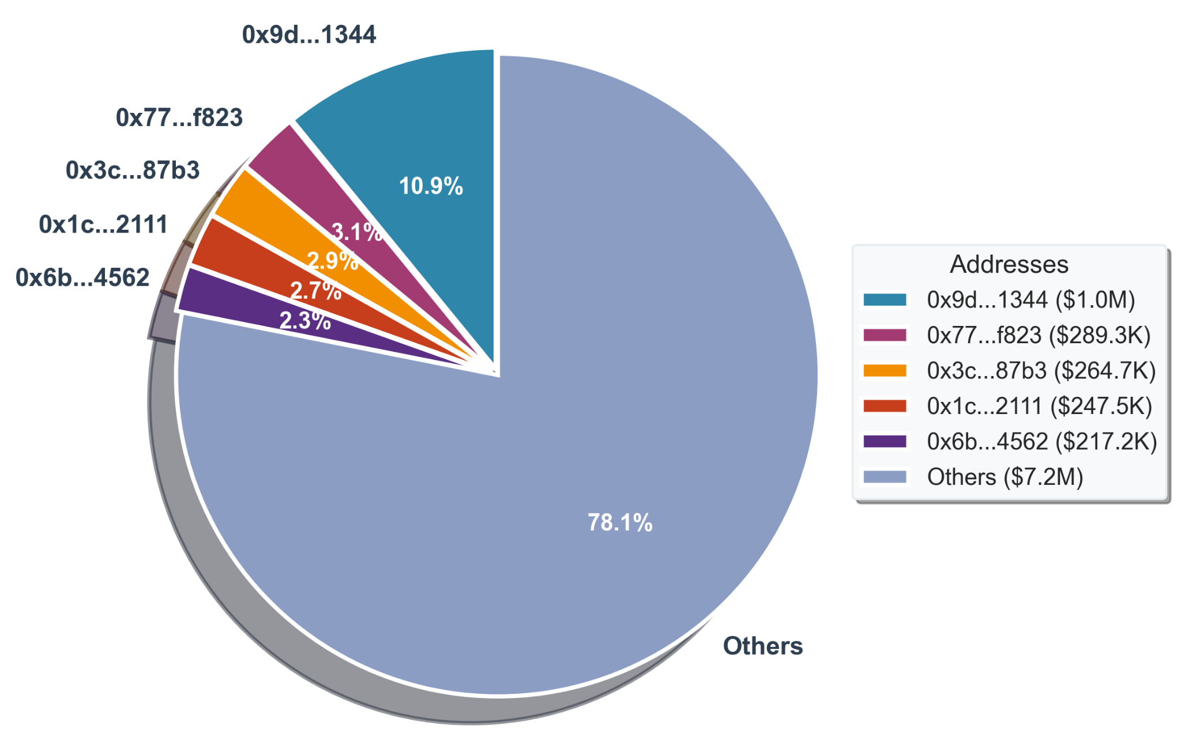
Results (CLOB)
Rewards distributed by Polymarket
Total Rewards Distributed - $9.3M
Highest rewards in a week - $242K
Highest earning by a single address - $1M

Slide 36
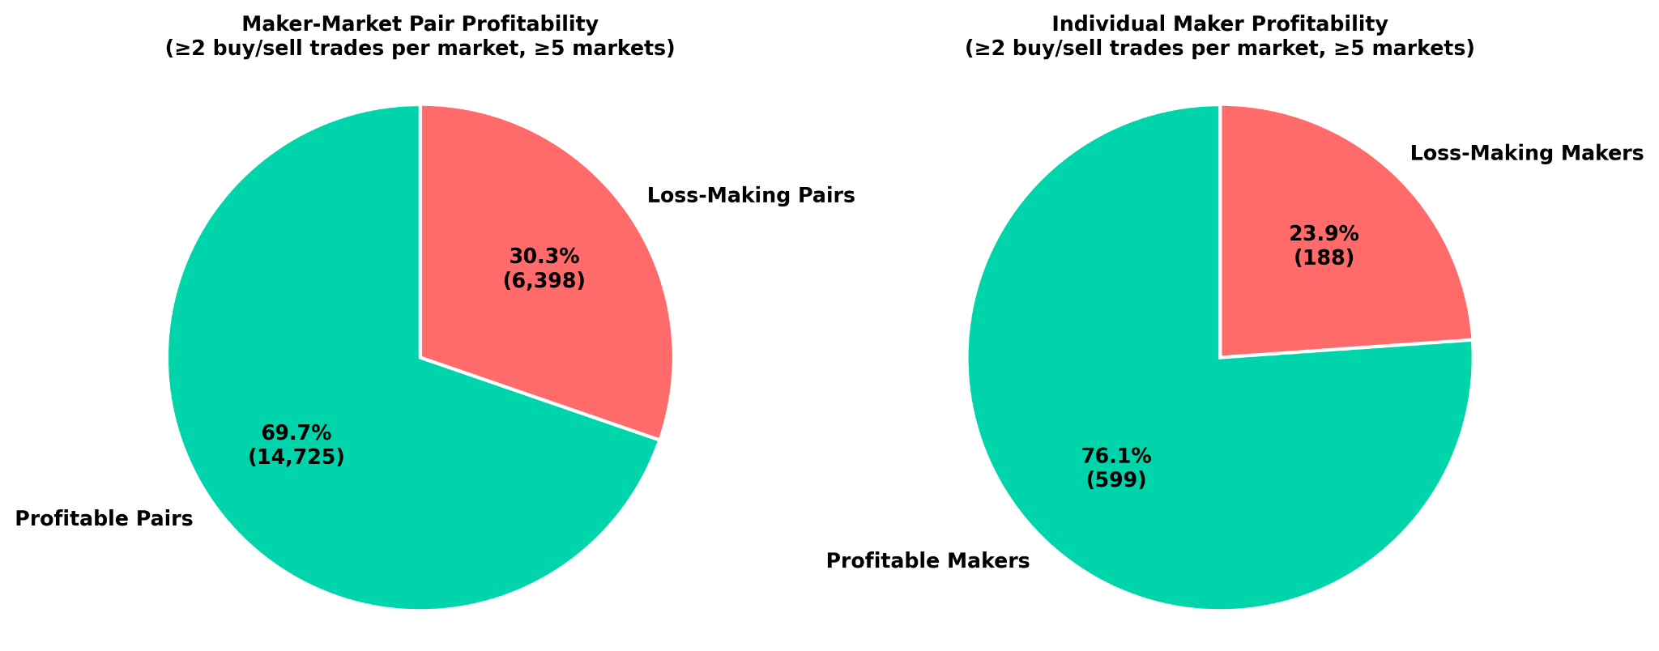
Results (CLOB)
Profitability pie chart for LPs and LP-Market pairs
Majority LPs and LP-Market pairs are profitable
*This PnL is excluding rewards earned

Slide 37
Outline
Background and Motivation
Research Questions
Methodology
Results
Conclusion

Slide 38
Conclusion
AMM
Liquidity provision in AMM-based markets unprofitable for passive liquidity providers.
Profitable LPs adopt various strategies such Just-in-Time Liquidity and removing liquidity before market resolution.
CLOBs
CLOBs are generally more profitable for LPs.
Earn through spreads and rewards.
Need to consistently update the bids and asks in order to remain profitable.
Understand the reward distribution algorithm to place quotes near the midpoint and on both sides of equal size.

Slide 39
Conclusion
Final Verdict on designing prediction markets
AMMs enable price discovery algorithmically, don’t require market making, although highly unprofitable.
Other designs of AMMs such concentrated liquidity design could be explored.
CLOBs prove more profitable for LPs although require active market making.
For new markets, AMMs would still prove to be more feasible in terms of price discovery as no LPs are required

Slide 40
Parshant Singh
parshant.singh@tum.de
17132
matthes@in.tum.de

Slide 41
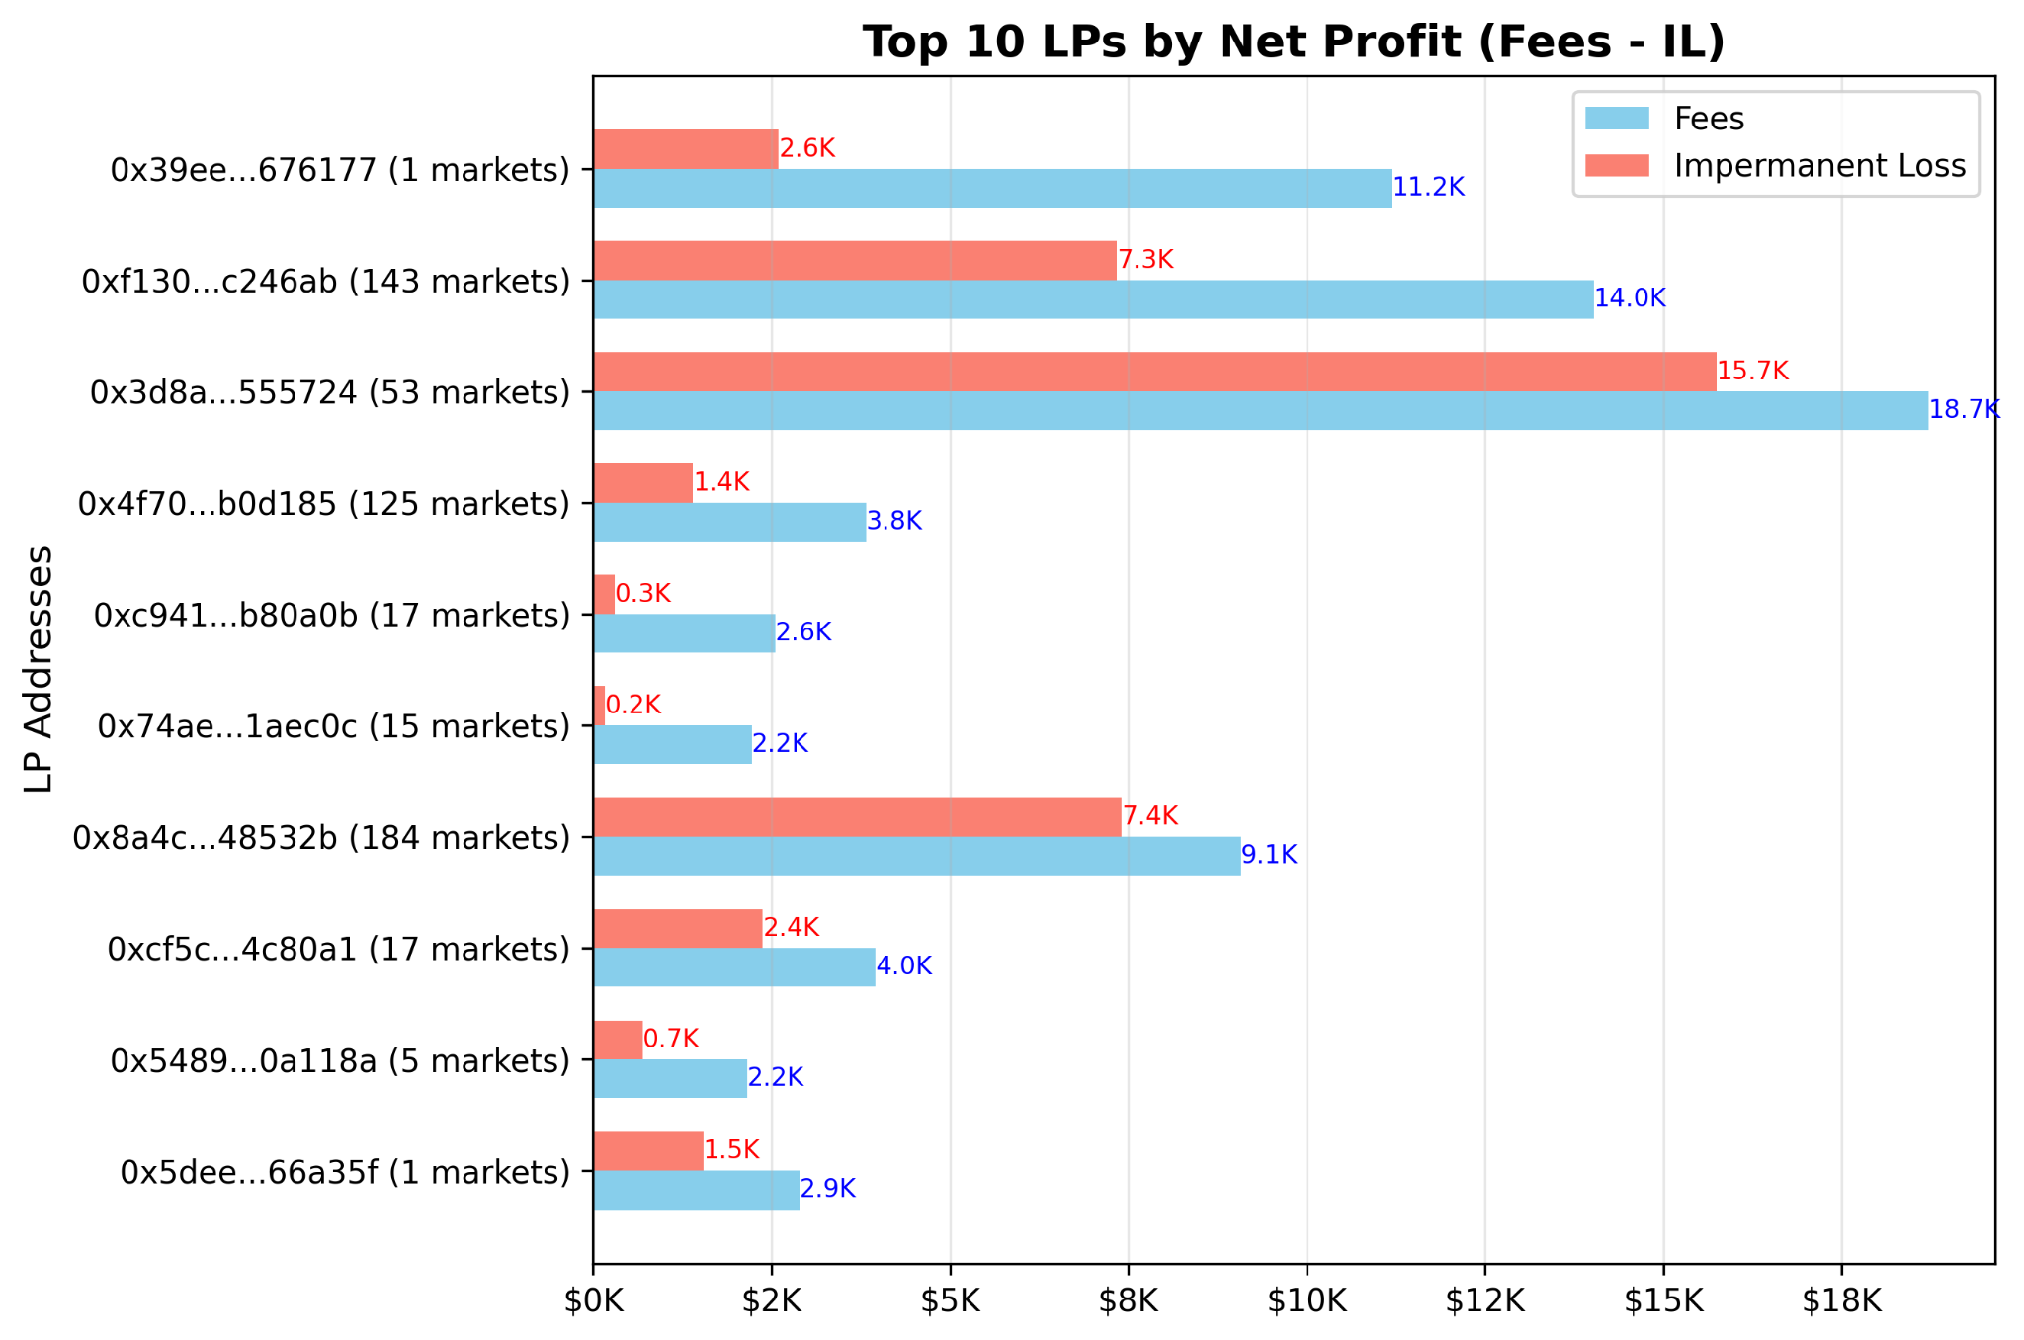
Results (AMM)
Top-10 most profitable LPs and corresponding total IL
Highest profit earning LP $8.6K
Will EIP-1559 be implemented on the Ethereum mainnet by August 5, 2021?

Slide 42
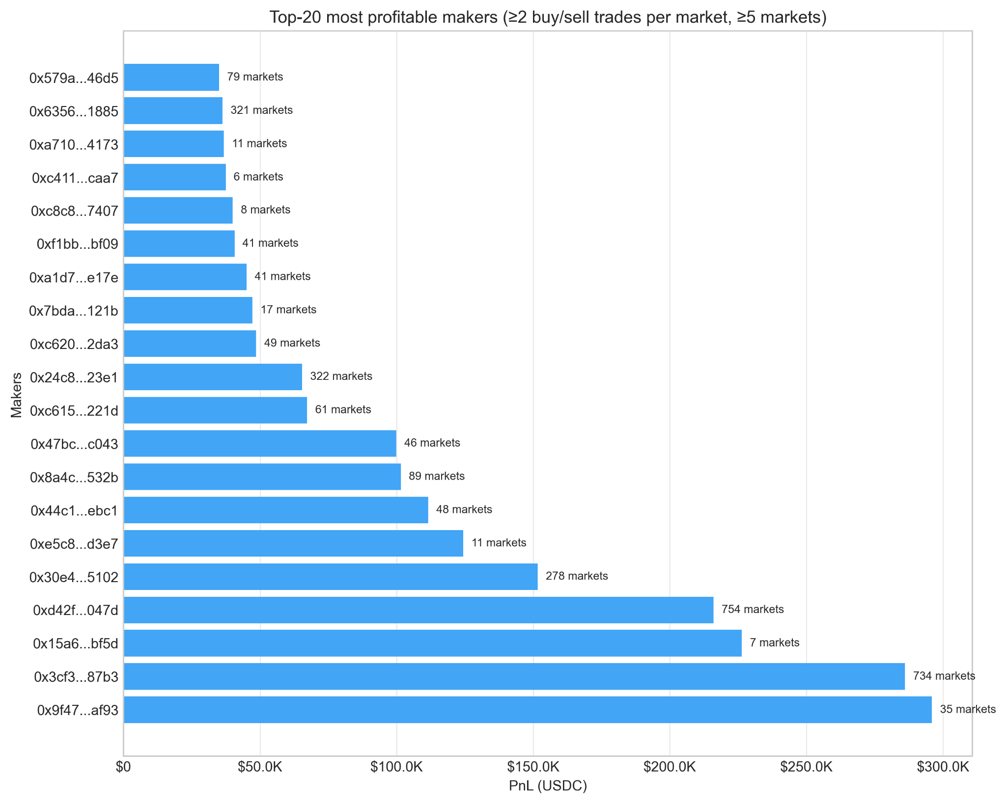
Results (CLOB)
Top-20 most profitable makers
Highest earning LP ~$298K across 35 markets (Jun 23-Oct 24)
Highly active LPs with a few involved in >700 markets.

Slide 43




Background and Motivation
  Prediction markets are platforms for betting on outcome of future events.
  Users can bet on an outcome by buying shares of outcome token.
  Price of the shares reflect crowd-sourced probability estimates
Centralised
Decentralised

Slide 44
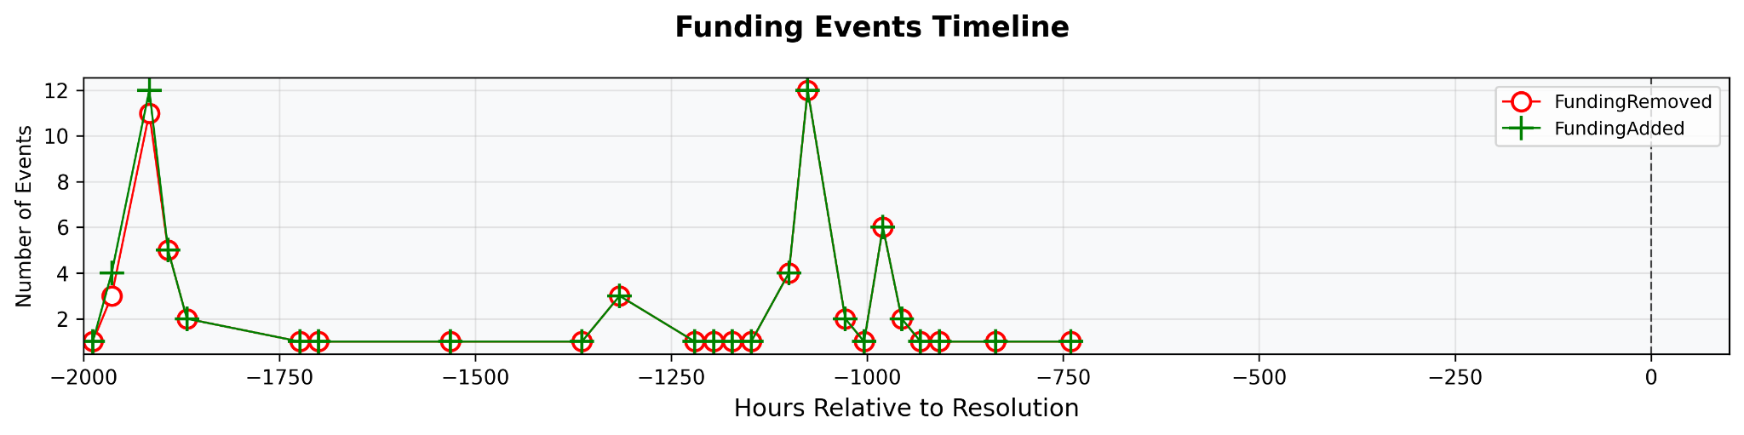
Results (AMM)
Just-In-Time Liquidity
Instances of Just-in-Time liquidity phenomenon, also known as LP sandwich

Slide 45
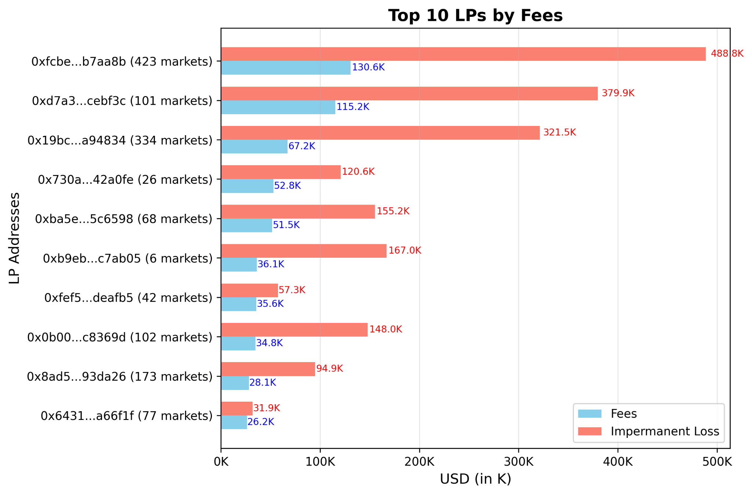
Results

Slide 46
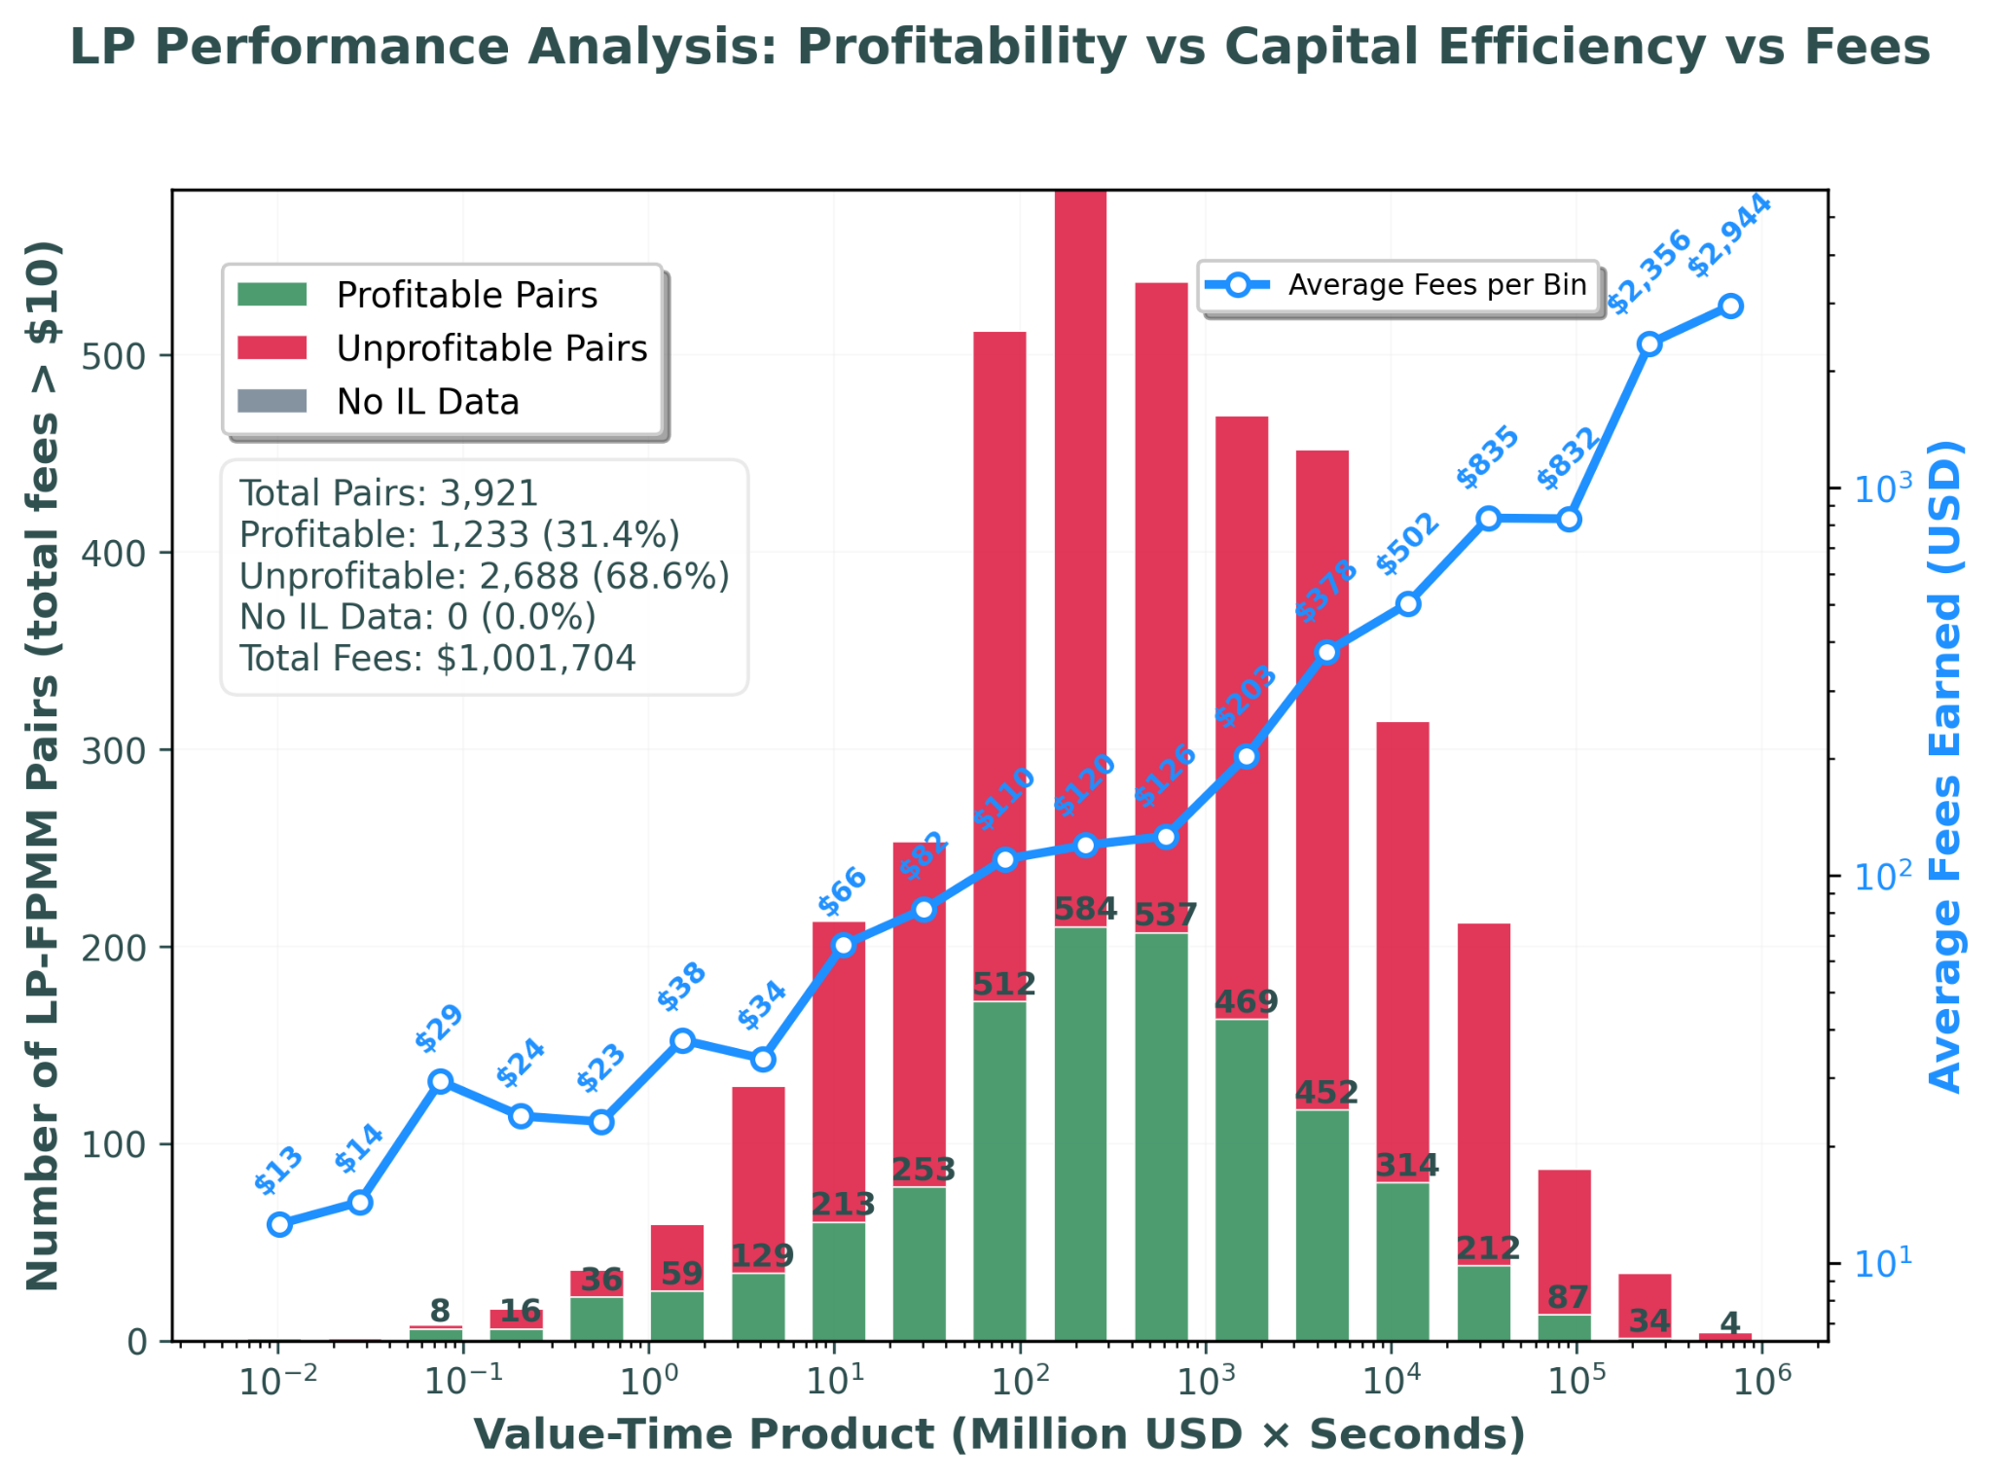
Results

Slide 47
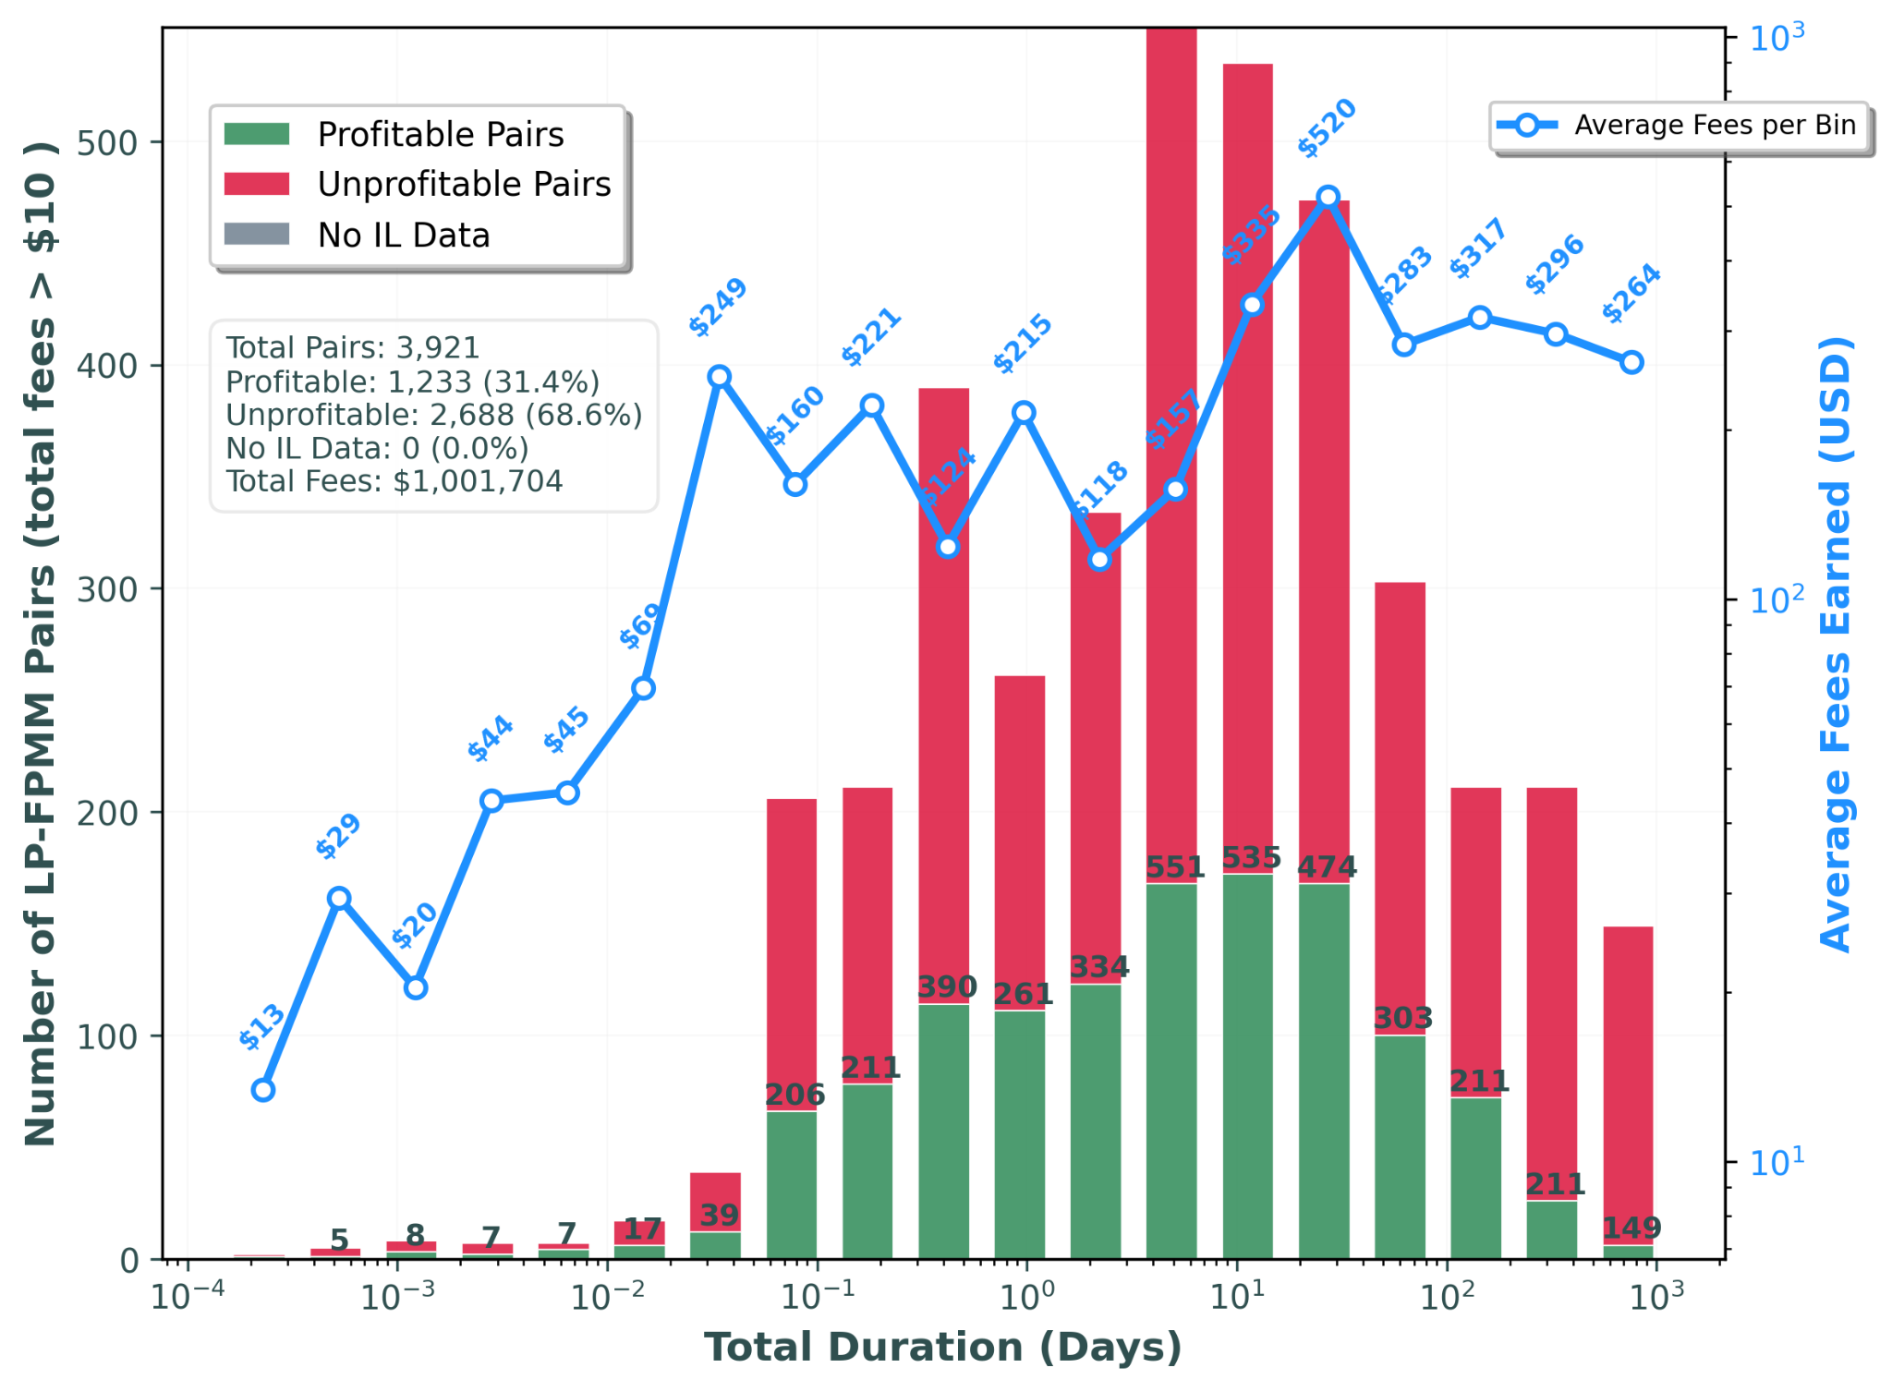
Results

Slide 48
Timeline
8th April, Registration
26th May, Kick-Off
8th October, Submission
April
May
June
July
August
September
October
Lit Review
Data Collection from sources
Data Analysis
Results
Writing Thesis

Slide 49
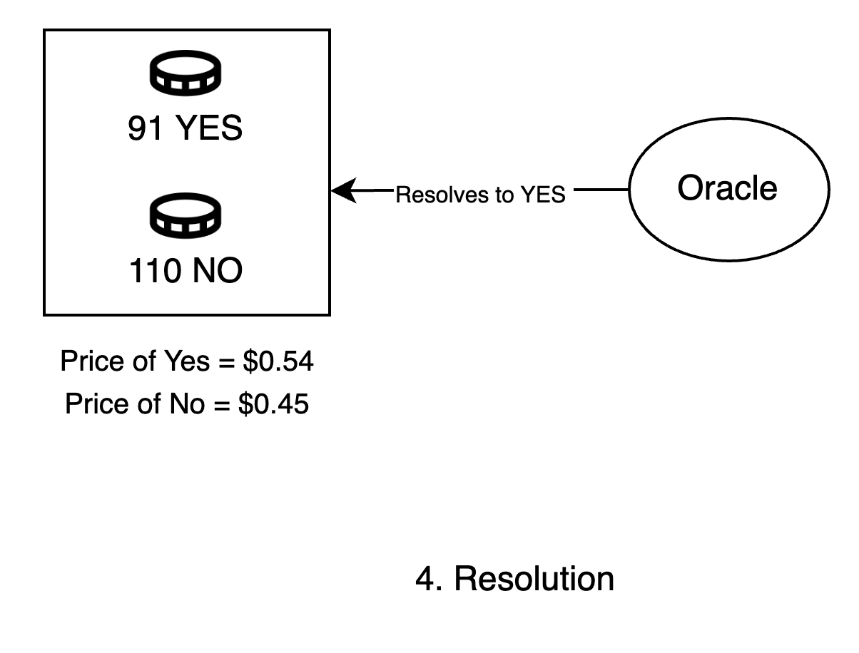
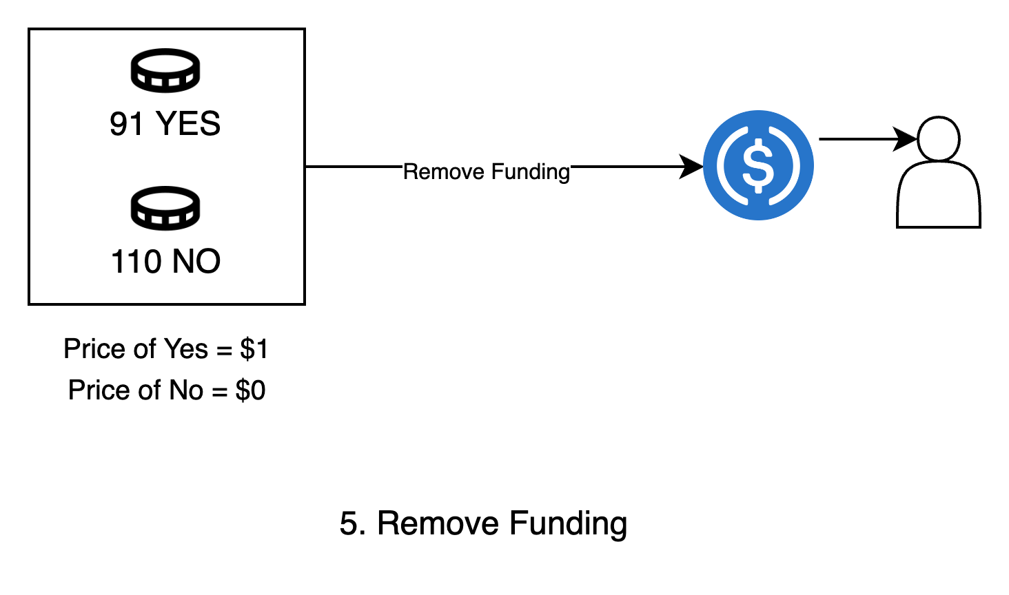
Background and Motivation
AMM and Impermanent Loss
91 USDC + Fees
Liquidity Provider
Impermanent loss is a temporary reduction in value experienced by liquidity providers (LPs) in Automated Market Maker (AMM) pools due to price fluctuations.

Slide 50
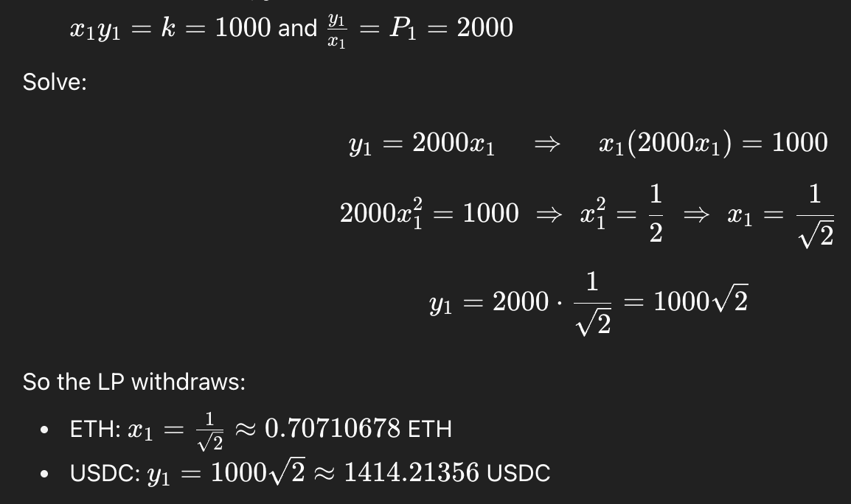
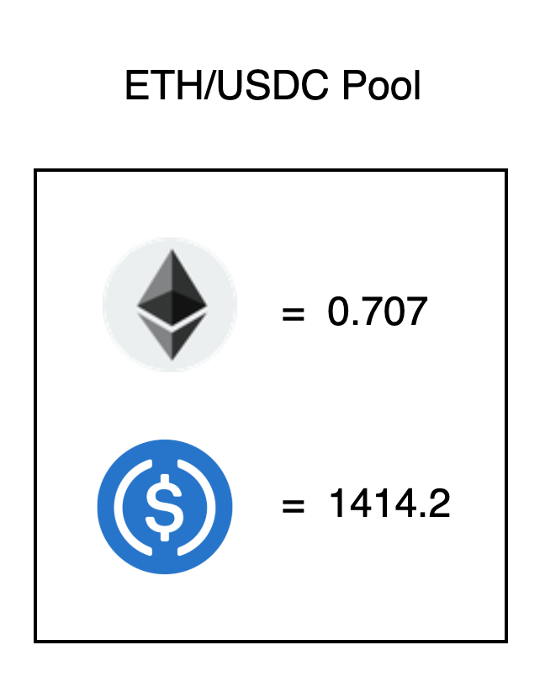
Background and Motivation
Price of ETH increases to 2000 USDC
Total value Alice withdraws now = (0.707 * 2000) + 1414.2 = $2828.4
Loss suffered = $3000 - $2828.4 = $171.6

Slide 51
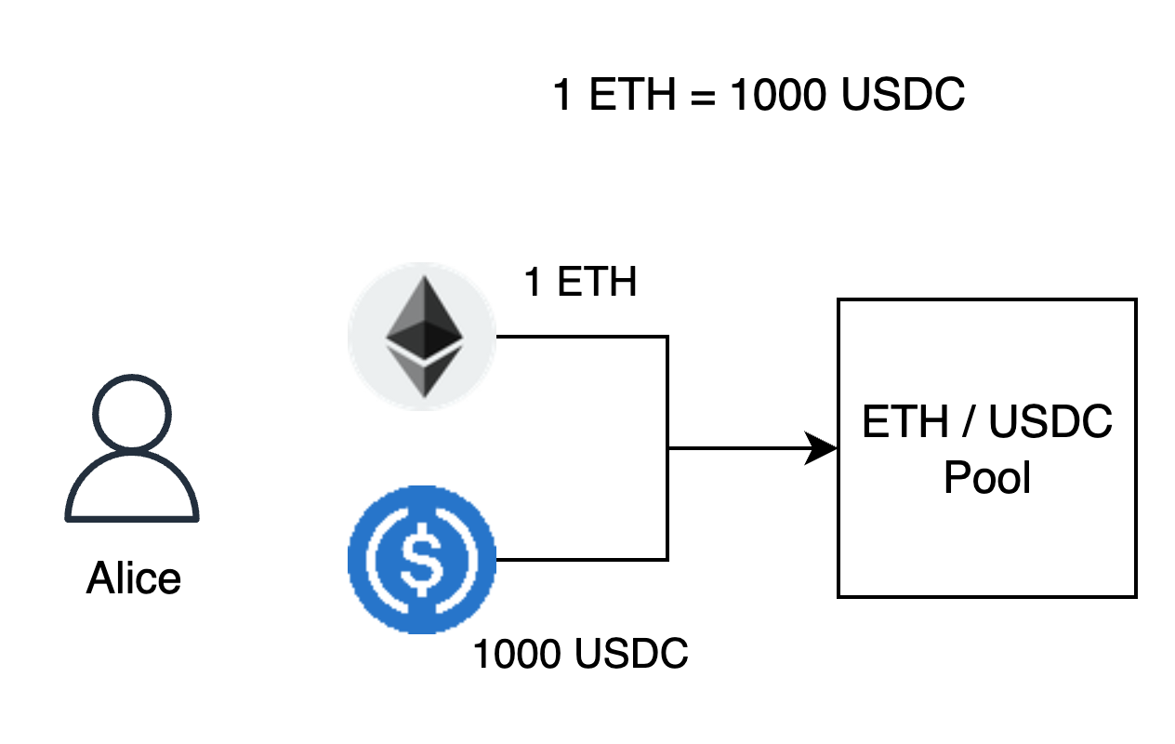
Background and Motivation
x.​y ​= (1)*(1000) = k = 1000
Total value locked = $2000

Slide 52
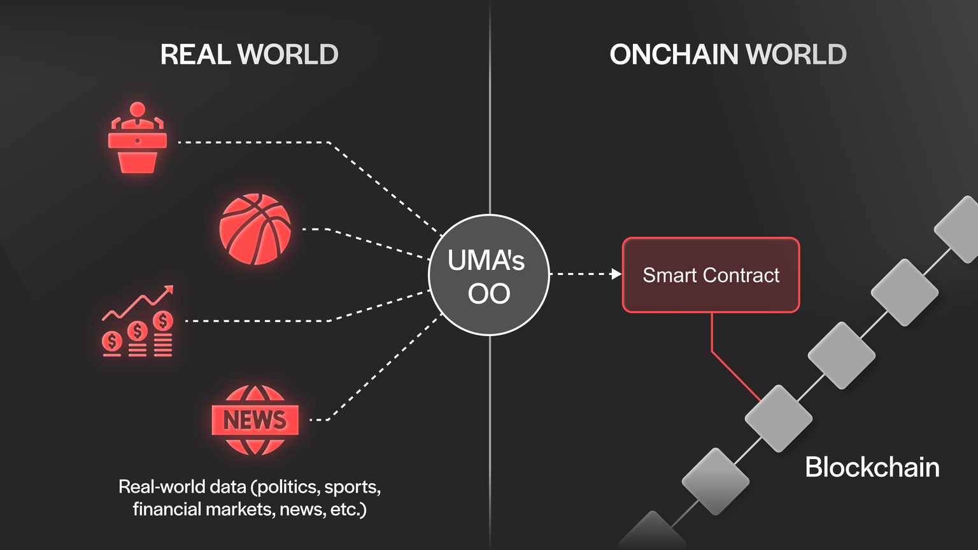
Oracles

Slide 53
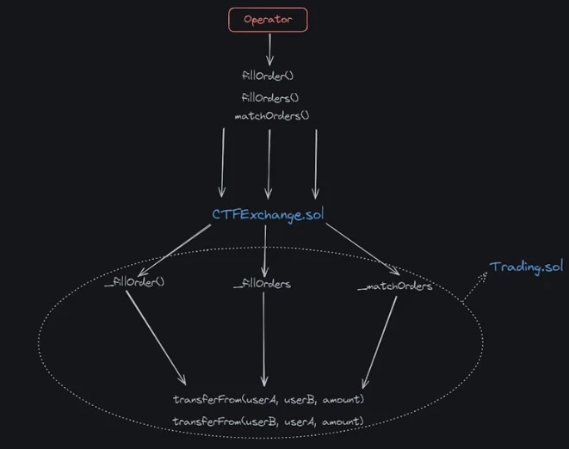
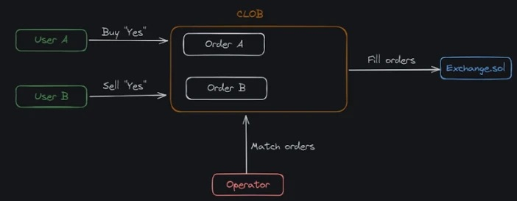
CLOB Polymarket

Slide 54
Motivation and Background Information

Slide 55
Outline
Topic
  Subtopic
Topic
  Subtopic

Slide 56
Stick to the good sebis traditions
  Provide action links at the bottom of the slide to guide the audience to our web pages or publications (see below). (Select the text, press CTRL-K)
  Use a file name according to our sebis conventions which helps us and our audience to find the file of your presentation on our web site with Google search:
    YYMMDD Author Short Title
    Include this string in the footer (Einfügen -> Kopf- und Fusszeile -> Fusszeile)
    The unusual date format simplifies the search for the latest version of a slide in an alphabetical directory listing (Dropbox, Explorer, Tricia, Sky-Drive)
[Ha13g] Hauder, M., Roth, S., Matthes, F.: Current Tool support for Metrics in Enterprise Architecture Management
For more information visit BEAMS , EAM Pattern Catalog and EAM KPI Catalog (http://wwwmatthes.in.tum.de)

Slide 57
Use the sebis visual language
(shapes, fonts, colors, sizes)
Default
Line Style
Default Rectangle
Default
Rounded R.
Text
Default
Text
User
Store
Information
Arrow
Cloud
Process
Box
Explanation
Fast
Form 1
Fast
Form 2
Fast
Form 3
Fast
Form 4
Fast
Form 5
Fast
Form 6
Fast
Form 6
Fast
Form 1
Fast
Form 2
Fast
Form 3
Fast
Form 4
Fast
Form 5
Fast
Form 6
Fast
Form 6

